Slide 1
Citi Bikes Analysis June 2023

Slide 2
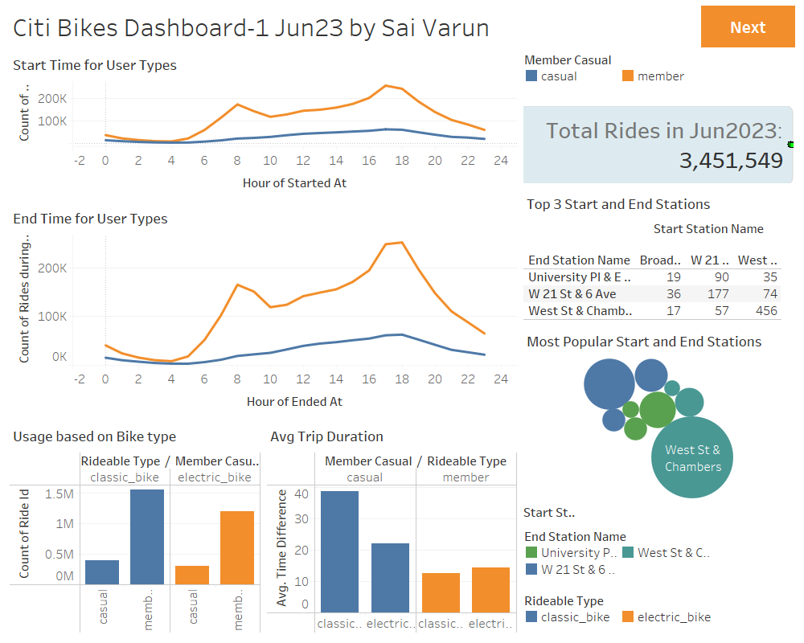

Slide 3
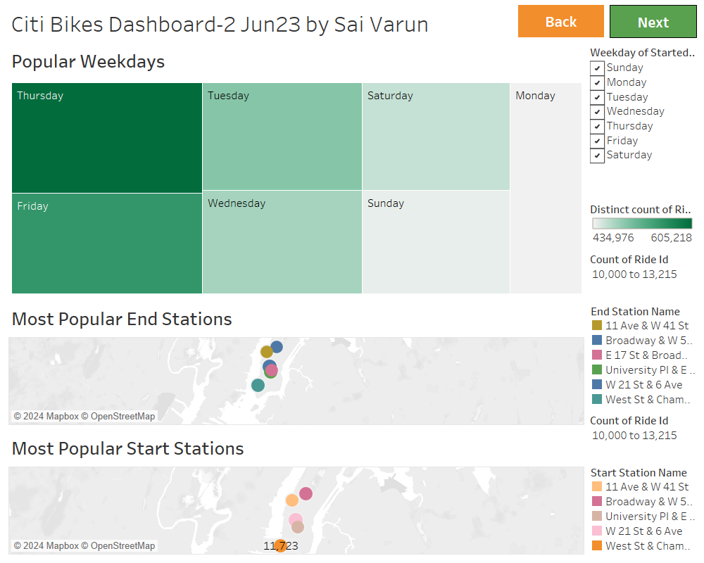

Slide 4
